Slide 1
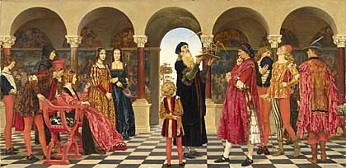
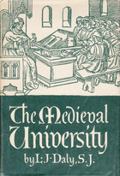
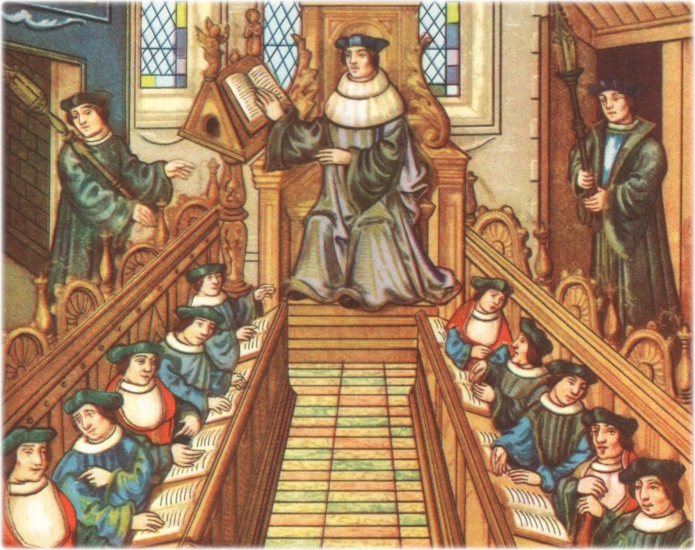
Monarchs needed literate, educated men to run their growing bureaucracies.
To supply them, schools appeared - some became universities.
High Middle Ages PPT #4

Slide 2
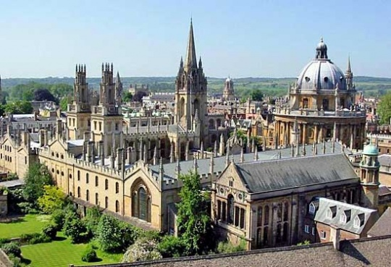
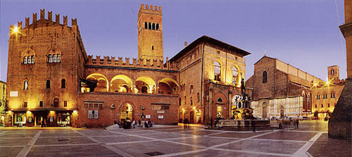
The earliest universities were founded in the 1100s at Salerno and Bologna in Italy, in Paris, and at Oxford.
Oxford University, England
Students followed a very rigid schedule:
5:00 A.M.
Prayers, then five hours of class
10:00 A.M.
First meal, then seven hours of class
5:00 P.M.
Light supper, study until bed

Slide 3
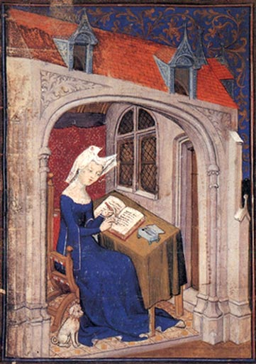
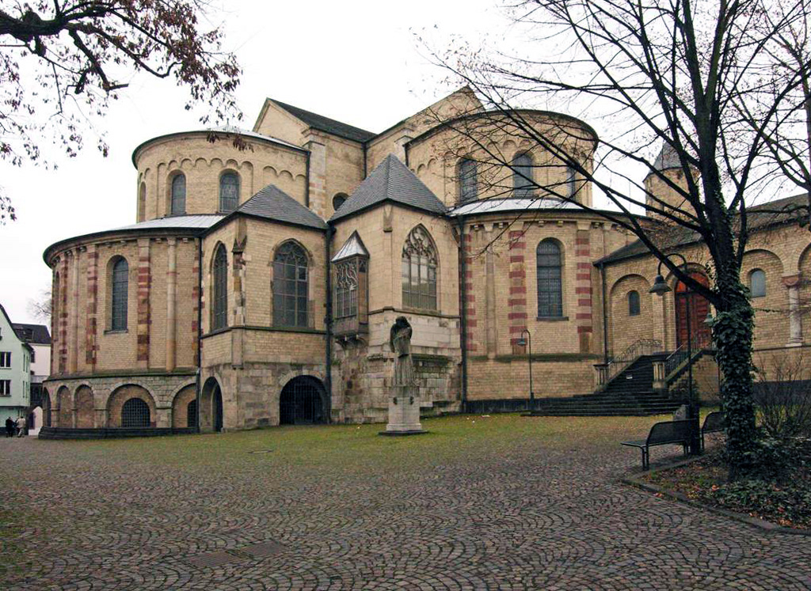
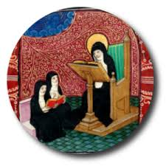
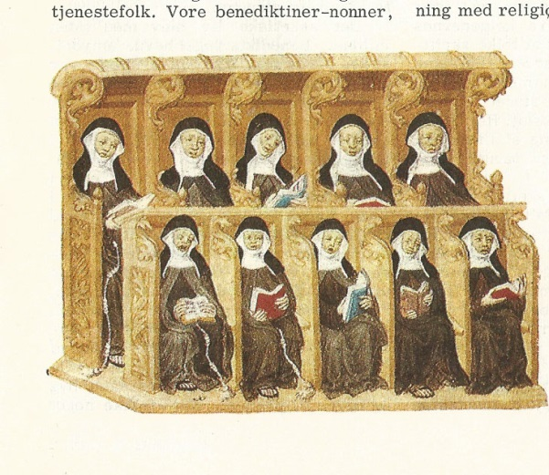
Women were not allowed to attend universities.
Some women did receive educations in convents

Slide 4
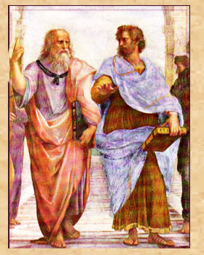
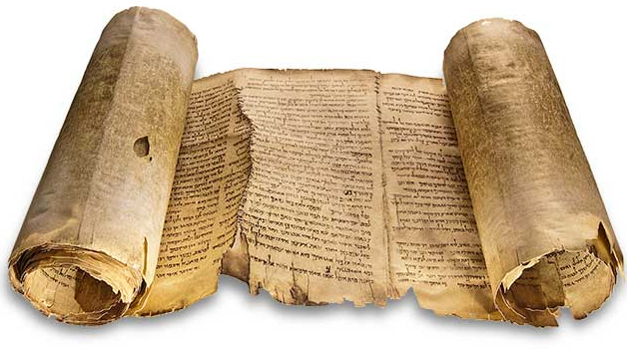
Prior to 1100s, Muslim scholars had translated & spread work of Aristotle & other Greeks. These were eventually translated into Latin and reached Western Europe.
Reason
Faith
The ancient texts:
Championed reason over faith,
challenged Christian scholars.

Slide 5
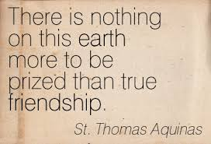
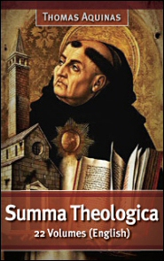
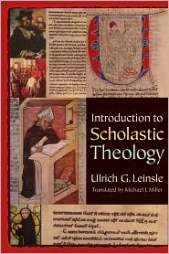
To resolve conflict between reason & faith ---
Christian scholars developed scholasticism, which used reason to support Christian beliefs.
Most famous scholastic - Thomas Aquinas:
wrote the Summa theologica.
Concluded that faith & reason existed in harmony
God ruled over an ordered, logical universe.

Slide 6
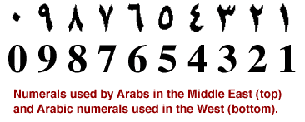
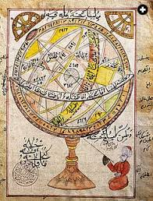
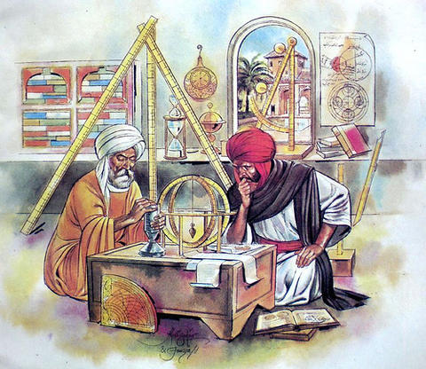
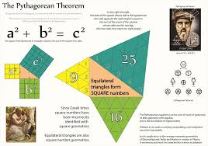
Europeans adopted Hindu-Arabic numerals, which were easier to use than Roman numerals.
Europeans studied Greek geometry and medicine, as well as works by Arab scientists.

Slide 7
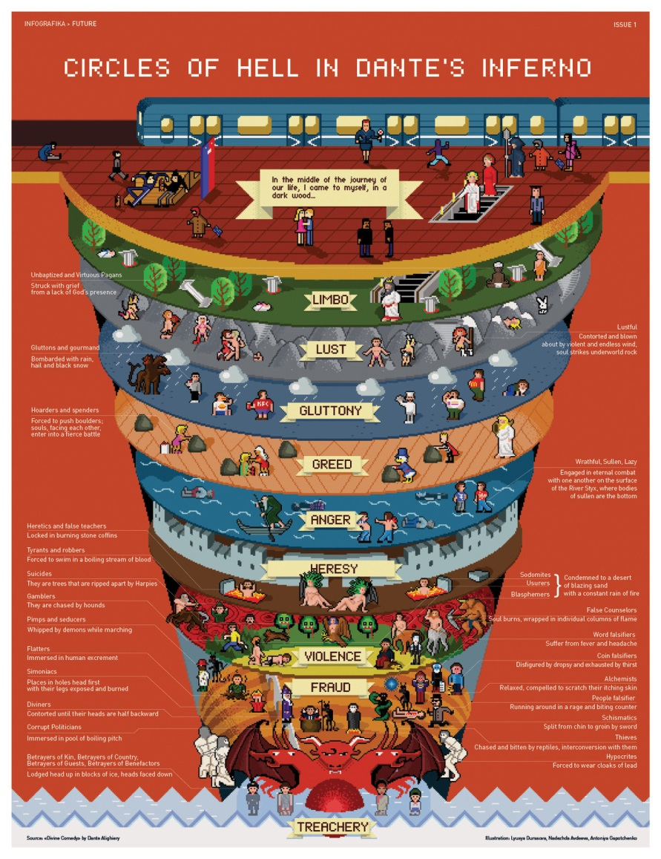
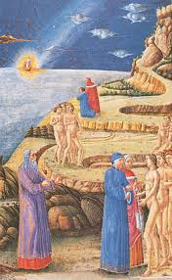
New writings began to appear in the: vernacular – the everyday language of ordinary people
Dante Alighieri – Italian poet who wrote the Divine Comedy
Dante Alighieri’s Divine Comedy is an epic poem that describes a journey through hell, purgatory, and heaven.

Slide 8
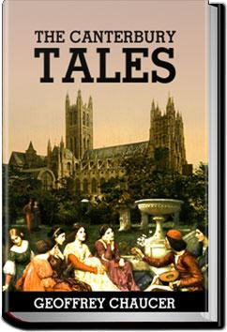
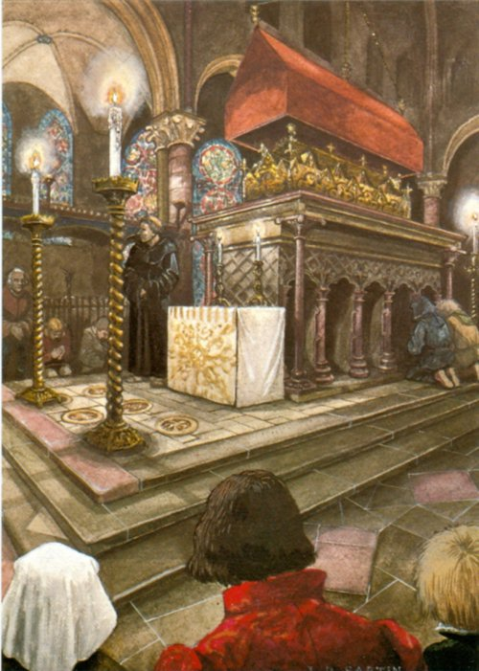
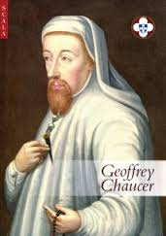
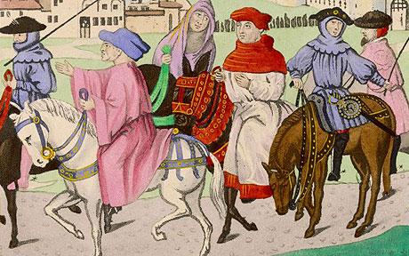
Geoffrey Chaucer – English writer of The Canterbury Tales
In Geoffrey Chaucer’s Canterbury Tales, a group of pilgrims of varied jobs and social classes tell stories while traveling to the tomb of Thomas Becket.

Slide 9
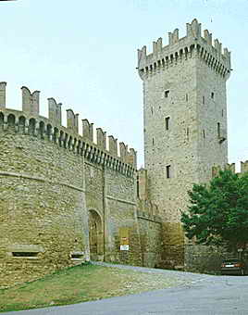
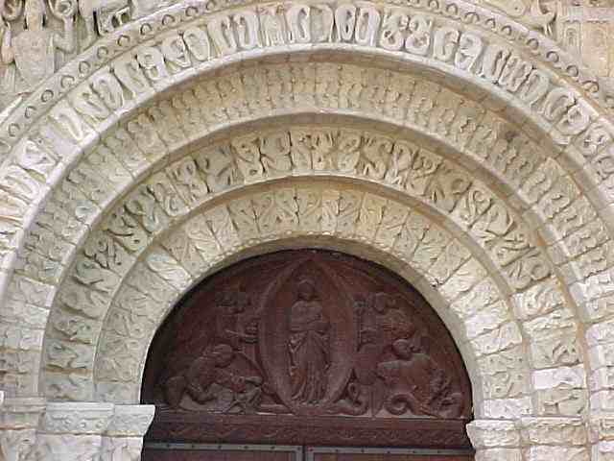
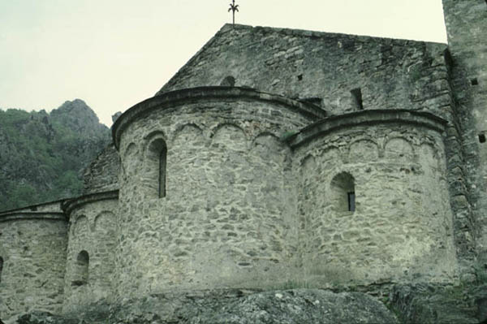
Romanesque Architecture was used for churches and other buildings in the early Middle Ages

Slide 10
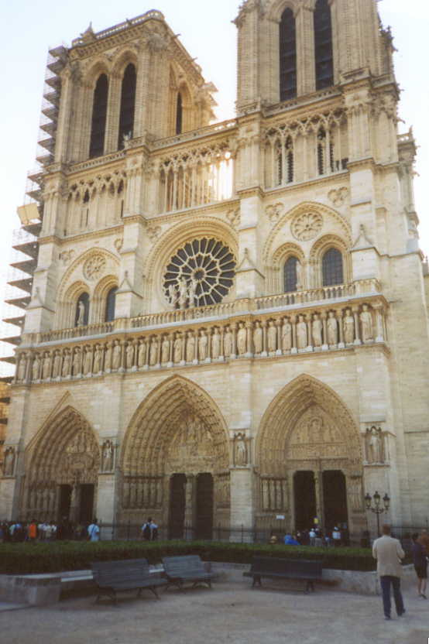
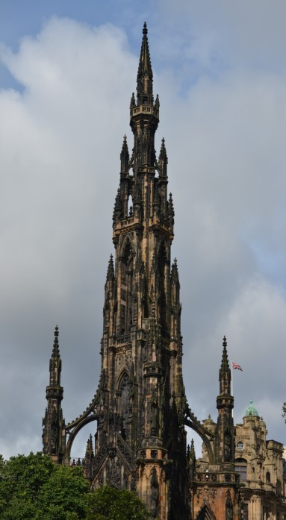
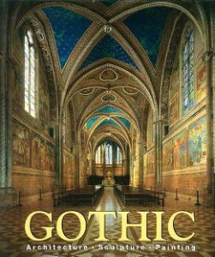
With new technologies - Builders developed the ornate Gothic style of architecture in the 1100s.
Gothic style – a style of architecture that used flying buttresses to support higher, thinner walls & left space for stained-glass windows

Slide 11
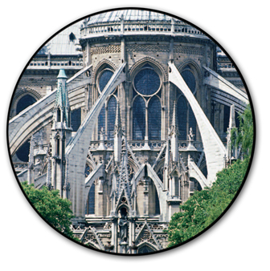
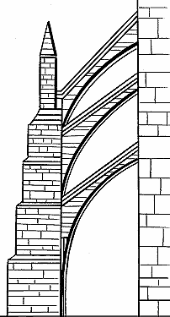
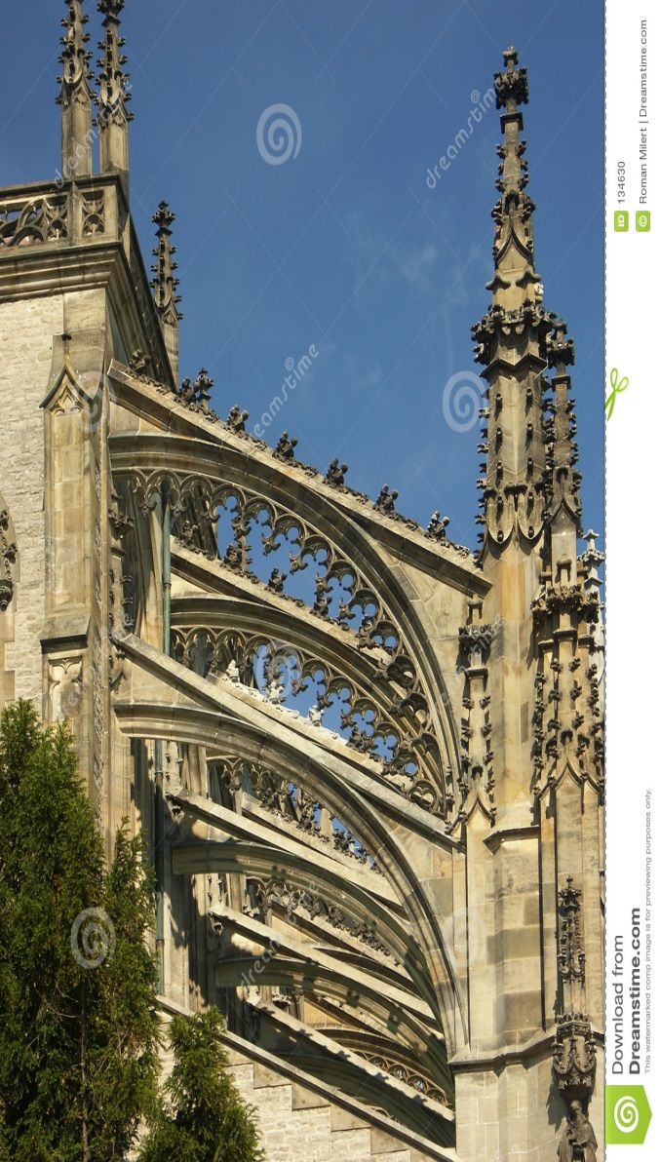
Flying buttresses allowed for higher, thinner walls.
Gothic cathedrals soared to incredible heights.
flying buttresses – external stone support for the tall cathedrals

Slide 12
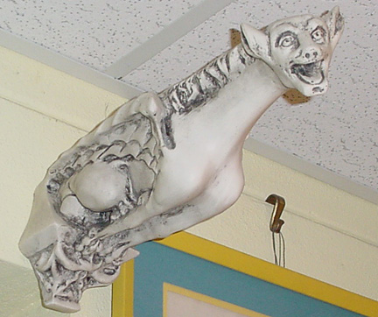
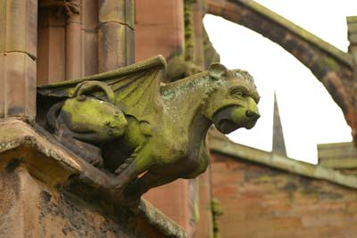
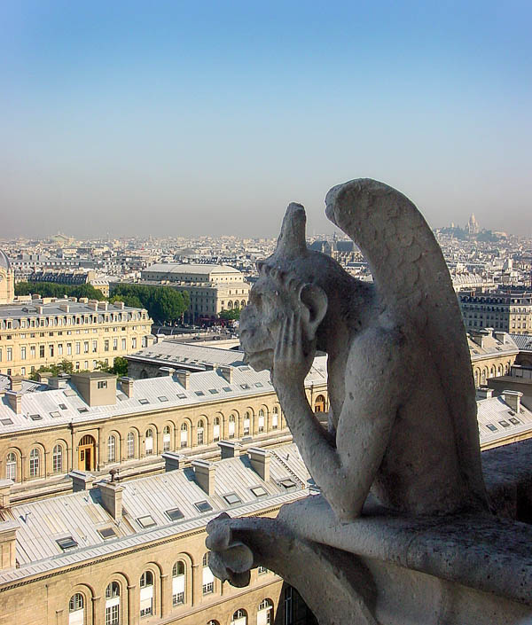
Gargoyles of Notre Dame Cathedral, Paris, France
Gargoyles served as rain spouts and other ornamentation - and were used to scare away evil spirits.

Slide 13
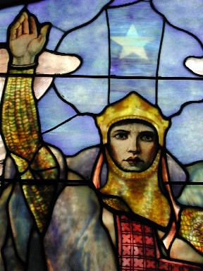
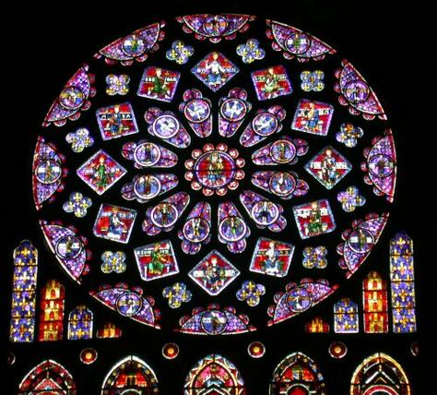
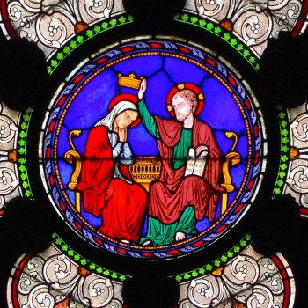
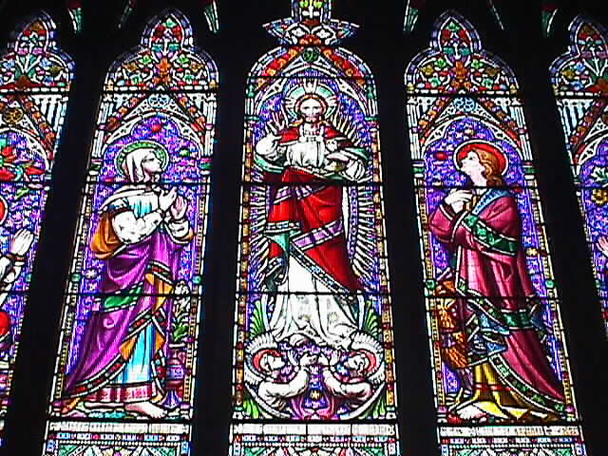
Stained Glass from Medieval Cathedrals
Gothic cathedrals, such as Notre Dame in Paris, contain beautiful stained-glass windows.

Slide 14
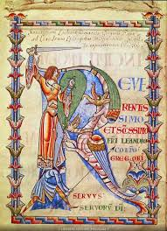
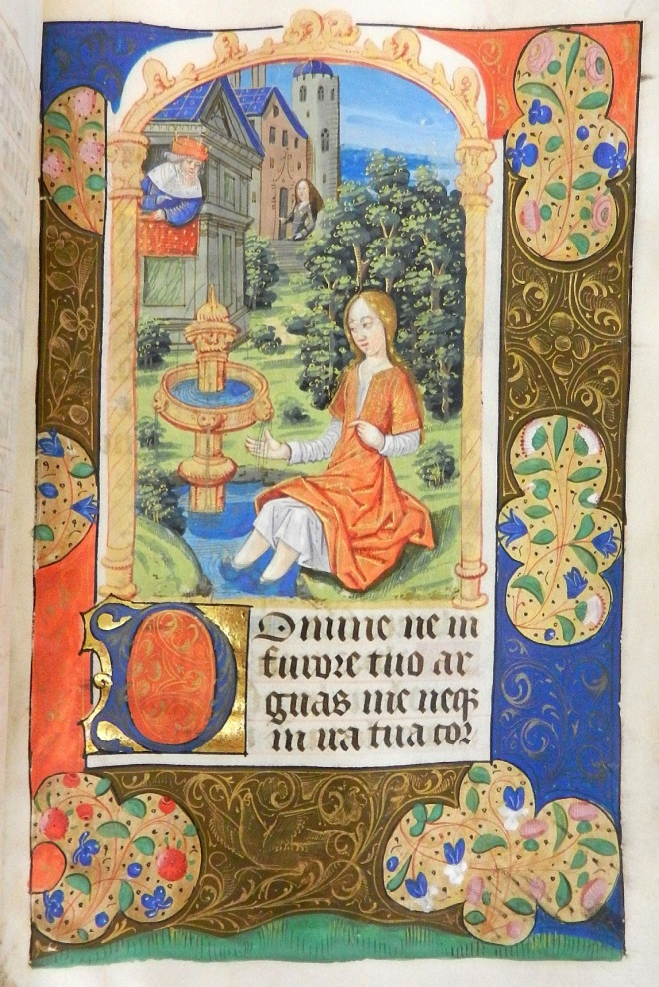
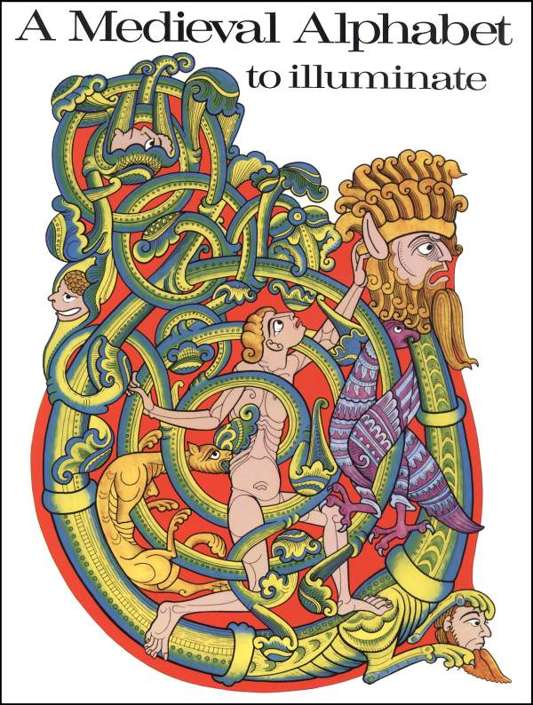
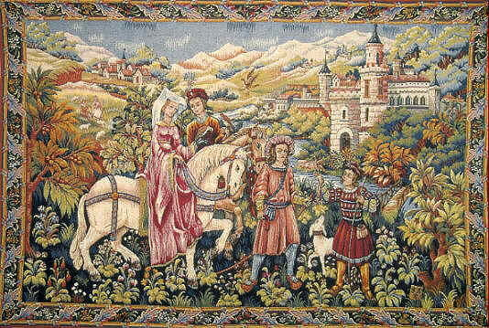
Other arts flourished during this time.
illumination – the artistic decoration of books
Monks and other artisans decorated books with intricate designs and pictures, an art known as illumination..
Artists created woven wall hangings called tapestries to keep the cold out of castles.

Slide 15
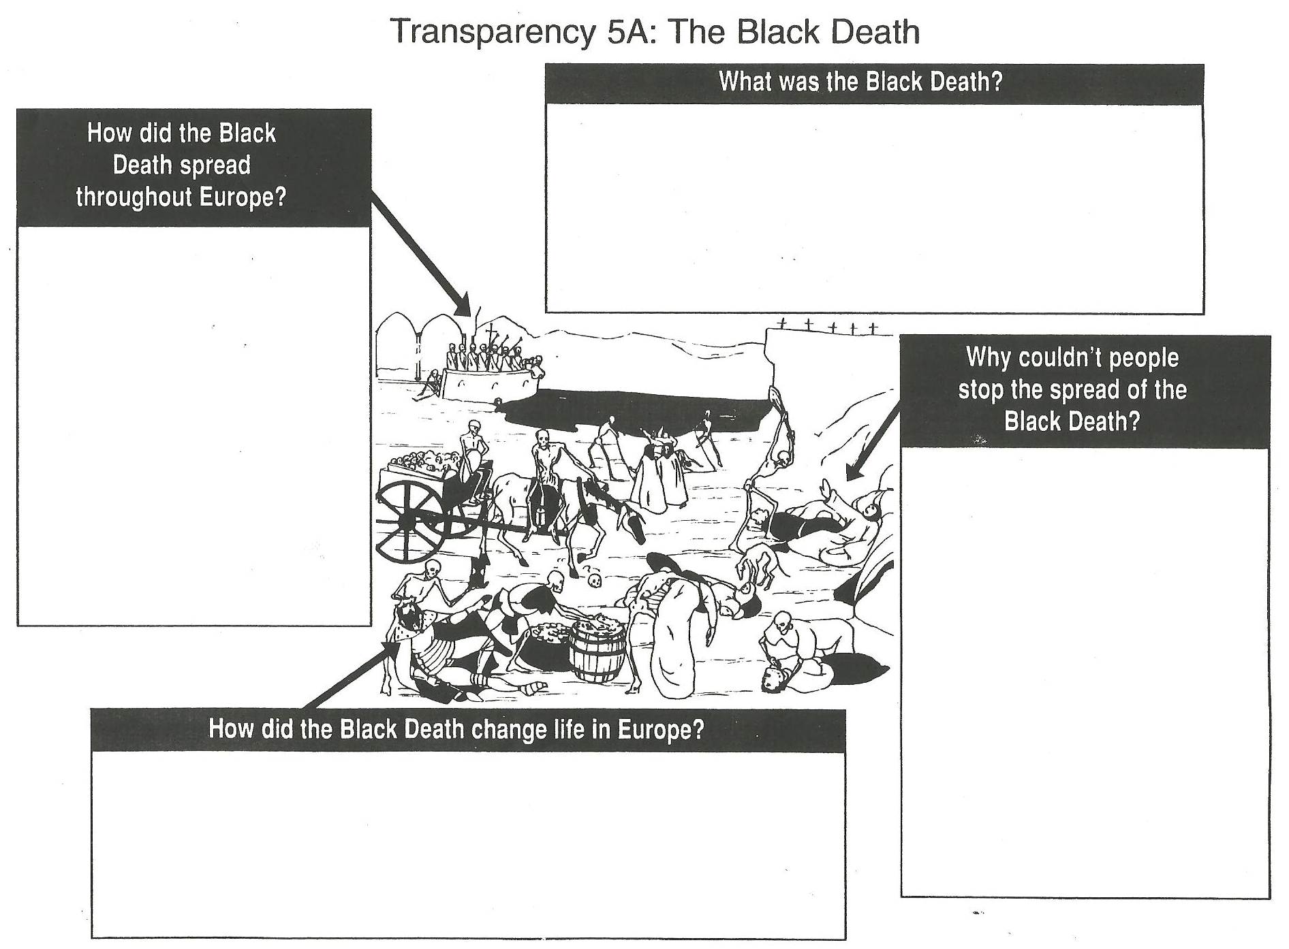
A deadly plague that spread across Europe from 1346-1352
Caused by bacteria – yersenia pestis
Appeared in 3 forms: 1) pneumonic attacked lungs / 2)Septicemic appeared in bloodstream 3) Bubonic caused buboes on the body
Originated in Mongolia and spread to Black Sea along silk road
Bacteria carried by fleas who lived on black rats
Italian merchant ships brought rats to Europe w/trade goods
First appeared in Sicily and eventually spread
People were ignorant about its cause; they blamed the stars, God’s anger, and the Jews.
They tried ineffective cures such as pomanders, flagellation, and repentance of sins
Killed one third to one half of the population
Forced farmers to diversify their crops
Peasants revolted and demanded more freedom
Working class moved to the cities to earn better wages
Reduced the power of feudal lords

Slide 16
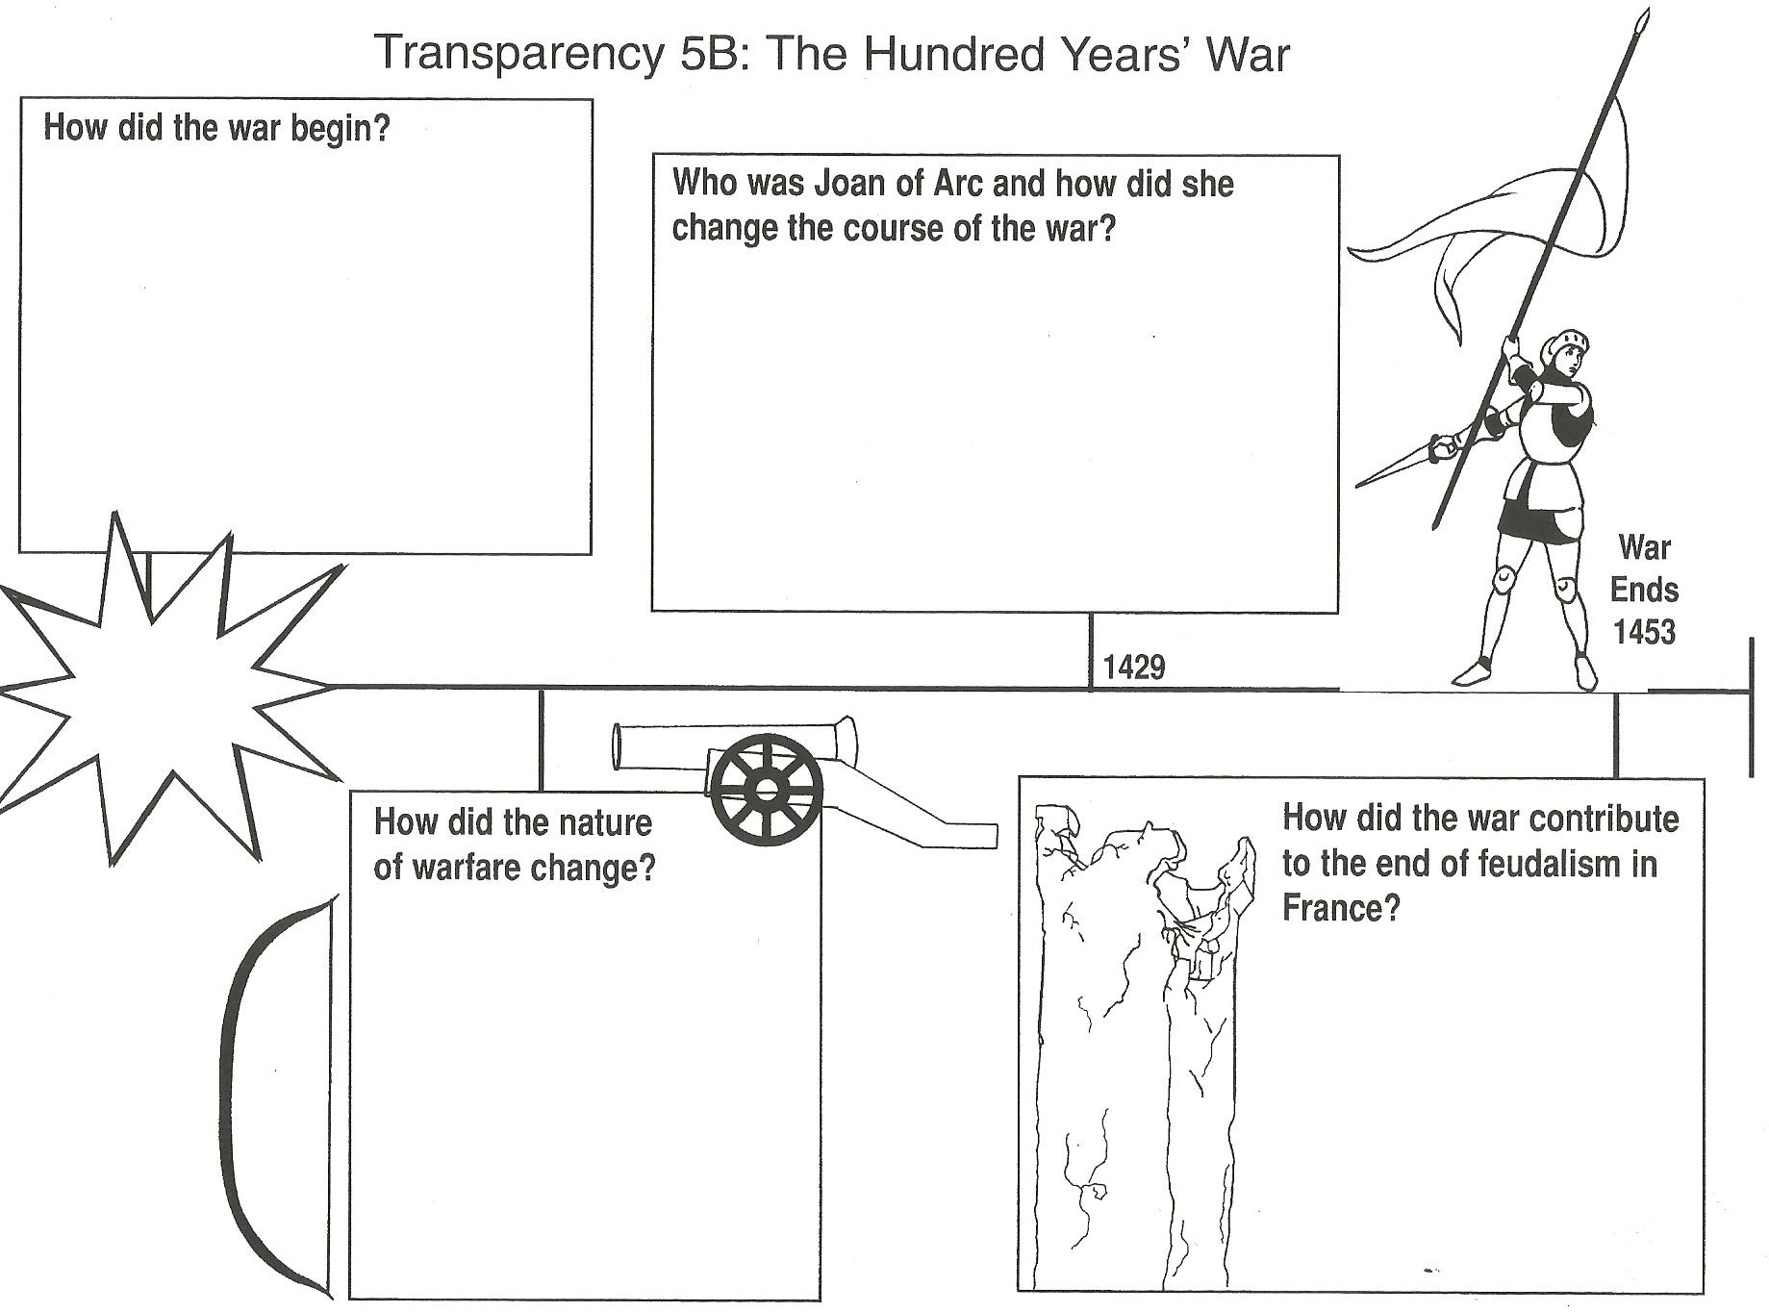
Lasted 116 years
French King Charles IV (4th) died in 1328 with no male heir
Two men fought for throne:
1) 1337- Edward III of England, whose mom had been a French princess – claimed throne
2) Philip of Valois, nephew of Charles also claims the throne
English armies attacked France
Young French peasant woman who was inspired by God to save France
Convinced Charles VII (the 7th) to let her lead an army against the English in 1429
Inspired the weary troops to rally & have hope
Helped push the English armies out of central France
Was captured, accused of heresy, and burned at the stake in 1431; was sainted in 1922
By 1453 the English held almost no land in France
War begins 1337
English Longbows eliminated the advantages of armor – helped them at the beginning
French Cannons could be used to blast holes in castles - helped them drive out the English
Monarchs used armies recruited from common people
People became more patriotic, more devoted to the monarch than their feudal lord
People developed a sense of nationalism and pride as a people
Monarchs built huge armies with the taxes they collected, which reduced the power of the nobles

